Slide 1

Functional JavaScript
iterative functions, array manipulations, function composition

Slide 2
Functional JavaScript
JavaScript is a multi-paradigm language
It can be used to program functionally
FP idioms:
iterative functions, which can replace loops,
list processing
function manipulations
immutability
pure functions
branching
... and many other things,
Can help us to keep code:
smaller
cleaner/readable/semantic
testable
reusable
maintainable
….
more fun

Slide 3
RECAP: 02.02-functions.pptx

Slide 4
Array iteration and processing functions
more readable array (list) iterations and transformations

Slide 5
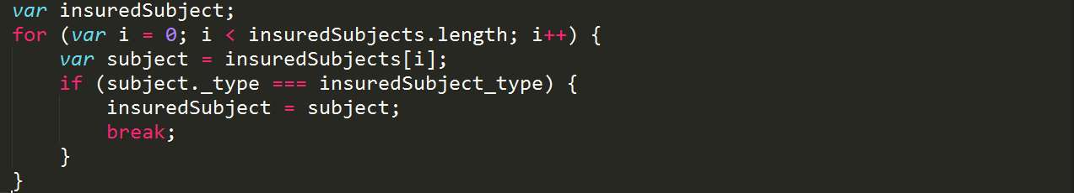
JavaScript – "ugly" "for"
for, while, do while
they exist from Basic … Java
Bad:
Verbose
Not semantic
Not reusable
Good:
…
keď sa pozriem na FOR cyklus neviem čo robí, lebo
robiť hocičo
veľa vecí naraz
cyclomatic complexity
for, if,. for, while all nested

Slide 6
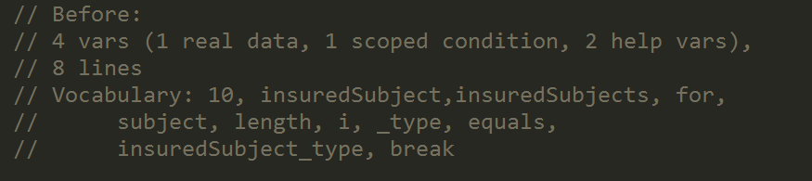

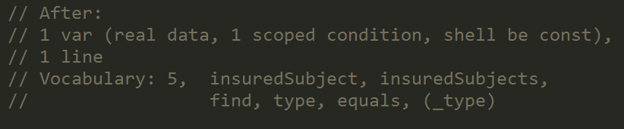
JavaScript - "ugly" "for"
How it is done
What it does
Notes:
Porovnanie z hladiska syntaxe,
Funkcionalny kod (dobre napisany) obsahuje menej „balastu“ teda kadejakych technickych pomocnych premennych (10 vs 5 slov) a ma sancu lepsie vyjadrit bisznis podstatu algoritmu.

Slide 7
JavaScript - array extras vs ugly “for”
mapping variants of for, to semantic methods
Function | In | Out | loop eq. | ES
map | [], N | [], N | var [], for, push, return []
filter | [], N | [], M<N | var [], for, if, push, return []
reduce | [] | {}, [], whatever,… | var [], for, if, push, return {}
reduceRight | [] | {}, [], whatever,… | var [], for (i--), if, push, return {}
some | [] | boolean | var b, for, if return true
every | [] | boolean | var b, for, if return false
forEach | [] |  | for
find | [] of items | item | for, if return a[i]; return;
fill | [], item | [] of items | var [], for, push, return []
from | [], iterable | [] | var [], for, push, return []
Notes:
For loop is not semantic, looking at code you cannot tell (quickly) what is the code intention,
Different semantics have same/”similar” code shapes,
With well used iterative functions we can easier communicate purpose of the program

Slide 8
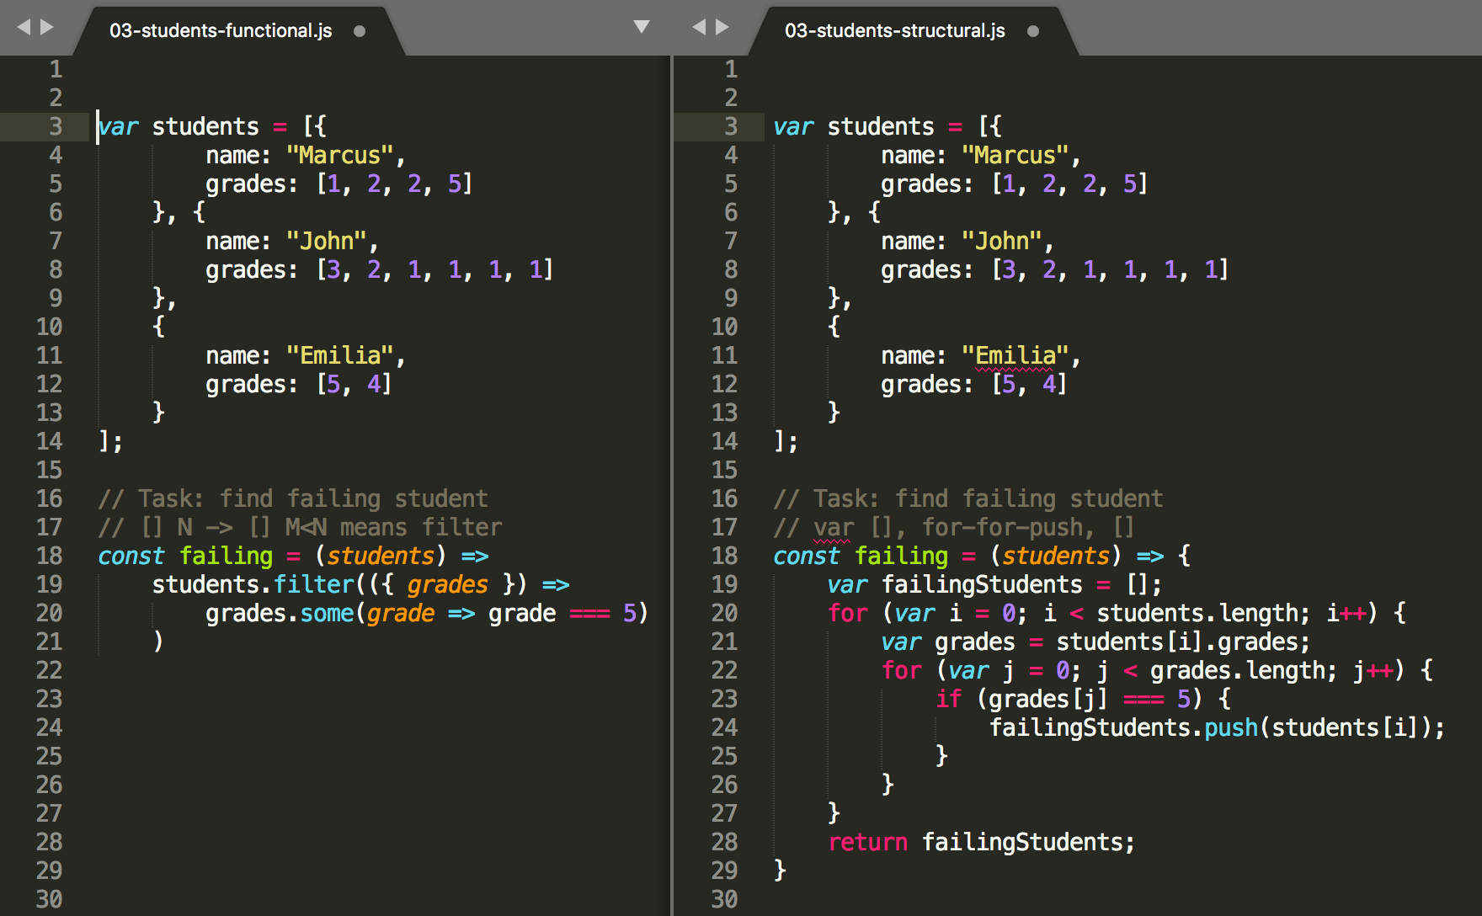
filter vs. for transformujeme [] N – [] M
TASK:
Nájdite študentov čo majú nejakú 5ku
/samples/01-iteration-functions/03-students-functional.js a
/samples/01-iteration-functions/03-students-structural.js
Notes:
Podstatne menej kodu na čítanie/“lúštenie”
Podstatne menej na písanie
Kód po prečítaní zodpovedá ”slovnému zápisu”: teda failing sú vsetci student filtrobaný podla tých kde niektora zo znamok je 5ka.

Slide 9
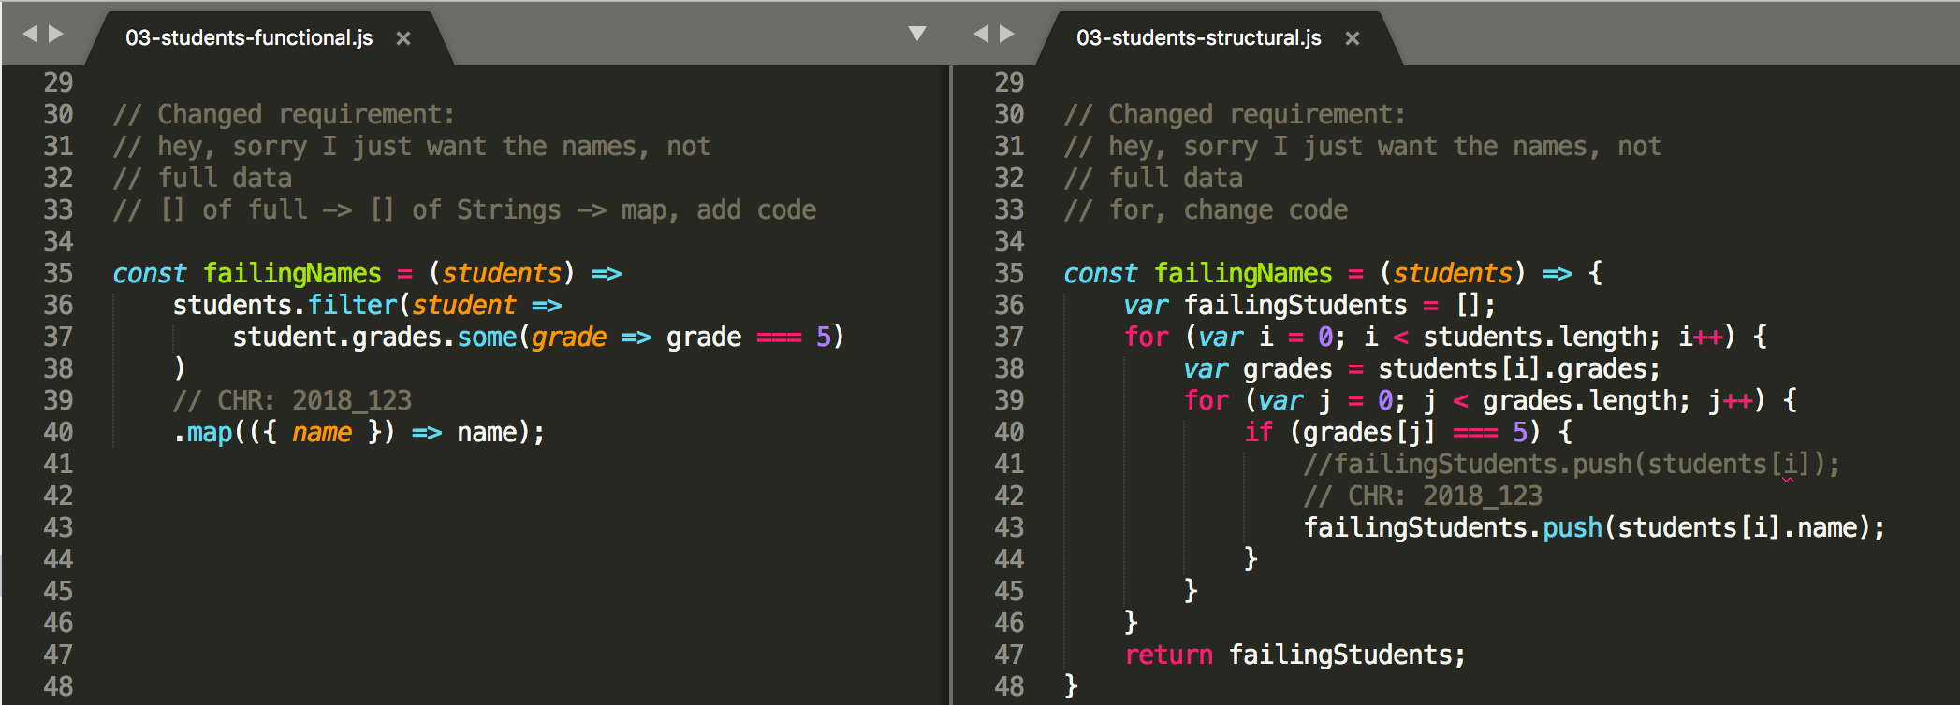
JavaScript - Array Extras vs ugly “for”
implementing changes in functional vs. structured
it can be addition
it is mostly change
/samples/01-iteration-functions/03-students-functional.js a
/samples/01-iteration-functions/03-students-structural.js
Notes:
Slide demosntruje ako sa realizuju zmeny v funkcionalnom vs strukturovanom kode.
Zmena strukturovanom kode spravidla znamena jeho modifikaciu, niekde v strede original kodu.
Zmena v funkcionalnom kode moze byt aditivna, teda pridanie nejakej dodatocnej konstrukcie (na koniec).
Je to podstatne lepsi sposob zmeny, aj kvoli jej „bezpecnosti“ aj naslednej detekcii (co sa zmenilo a preco) z historie (git diff)
V priklad:
/samples/01-iteration-functions/03-students-functional.js a
/samples/01-iteration-functions/03-students-structural.js
Si pozrite rozne zadania a „zmeny zadania od zakaznika“
A pokuste sa im implementovat v „for variante“, aby ste videli ako „lahko sa ro robi v FP“ a ako tazko (skaredo) sa to robi v SP.

Slide 10
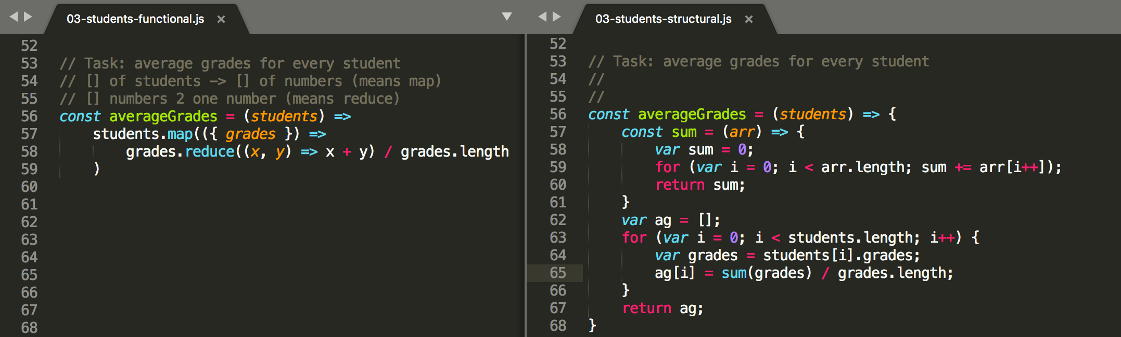
reduce vs. for
/samples/01-iteration-functions/03-students-functional.js a
/samples/01-iteration-functions/03-students-structural.js
Notes:
Nevravim ze tu for verziu by vsetci kodli takto, ale je to jedna z horsich variant ako to spravit, kvoli demonstracii

Slide 11
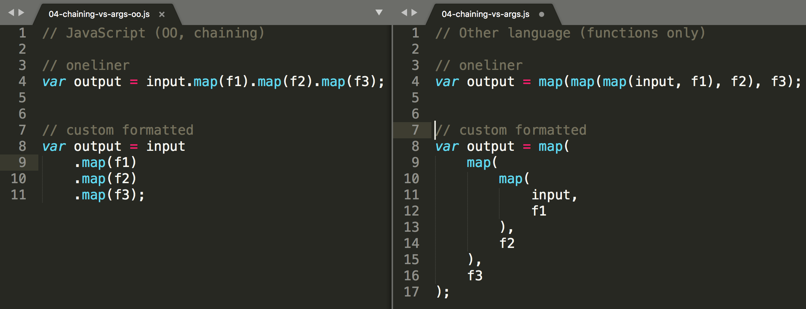
JavaScript - best of both worlds chaining of array functions
Notes:
Cisto objektovy zapis je menej citatelny (nestovane zatvorky)
Ale v JS mame objekty takze mame bodky a dokazeme to takto pekne zalomit....

Slide 12
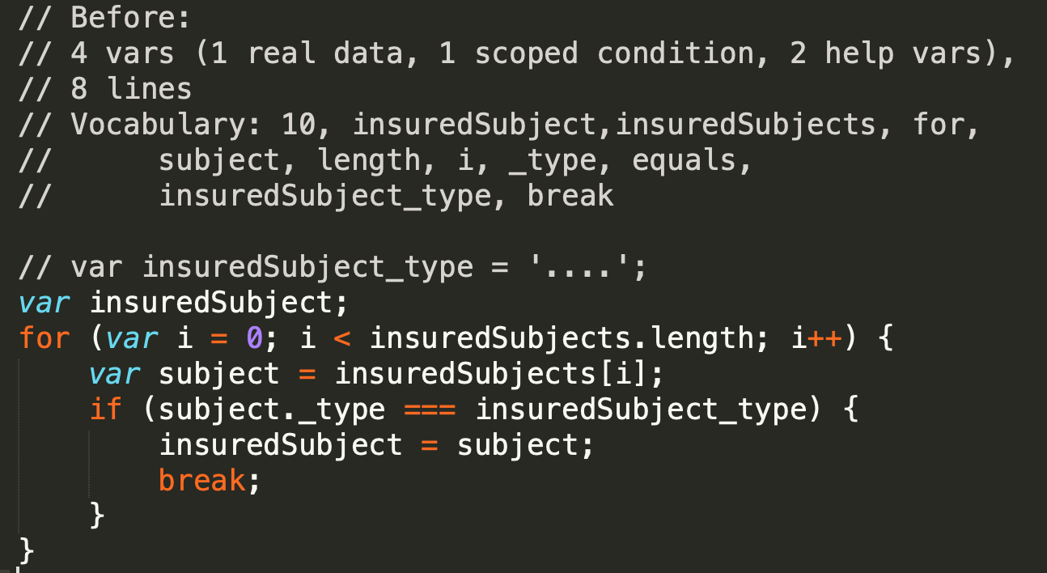
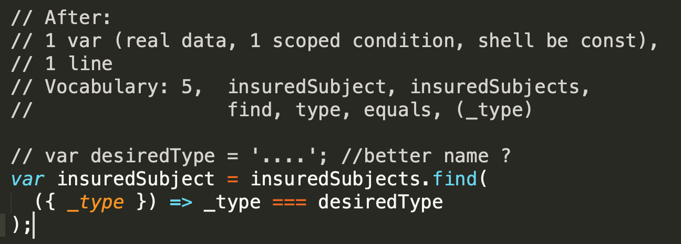
find vs. for
[] -> item
Common usecases
Hladame itemy z nejakou property
minima, maximama
...
/samples/01-iteration-functions/05-find-vs-for.js
Notes:
To je priklad z naseho realneho kodu, nejaka poistna kalkulacka,
Hlada vsetky poistene predmety podla nejakeho typu

Slide 13
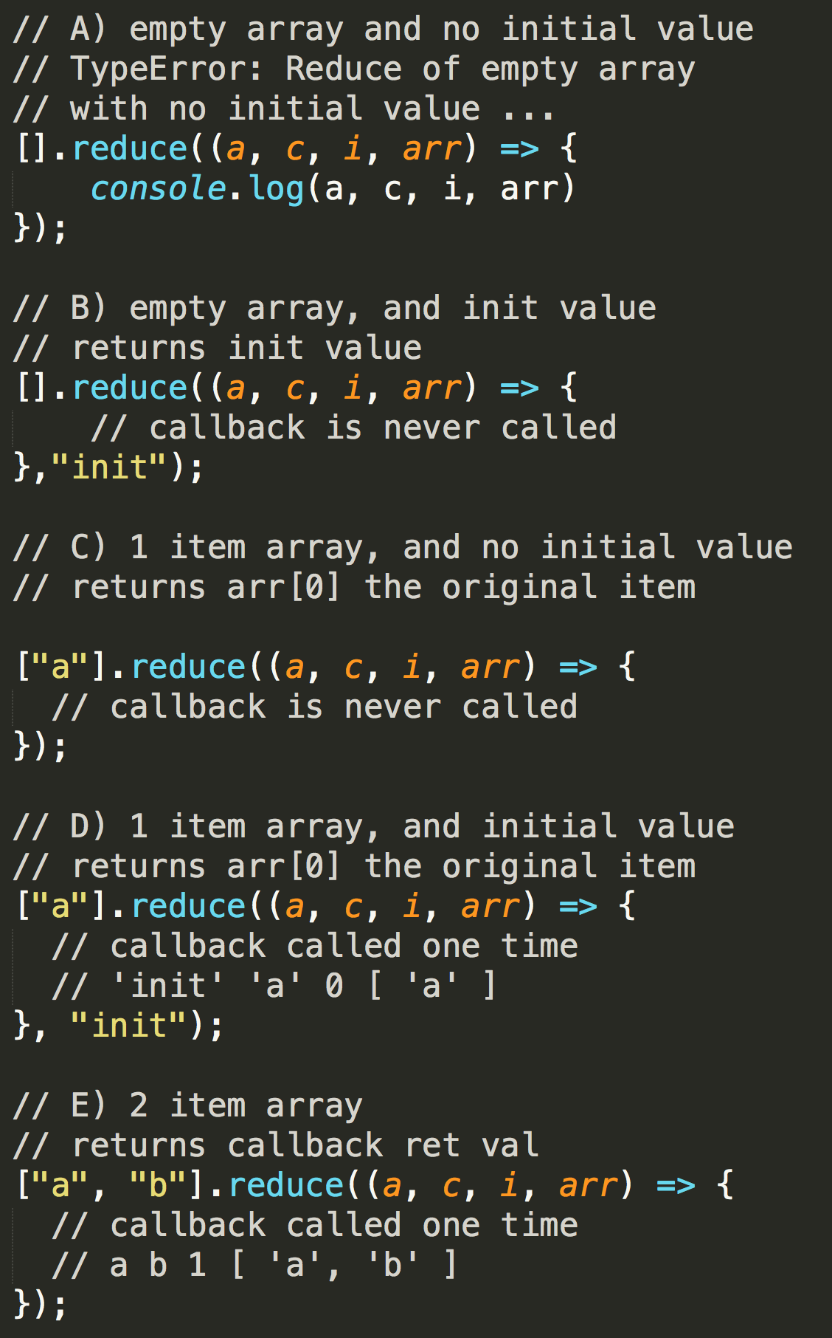
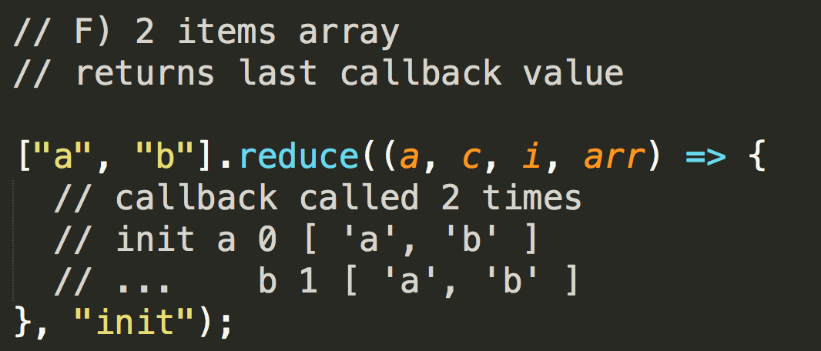
Ako funguje reduce, reduceRight
The reduce() method executes a reducer function (that you provide) on each member of the array resulting in a single output value. but .... read more ...

Slide 14
Reduce – načo sa používa
[] -> anything
Transform [] to number
sum, avg,...
Transform [] to {}
To restructure things
To create groups
Transform [] to Map
To create groups/counts
Transform [] to Set
To create unique items
Transform [] to []
„optimized“ filter/map operations
.
Transform [] to several [] [] [] arrays
Split data to groups
samples/01-iteration-functions/06a-reduce-number.js
samples/01-iteration-functions/06b-reduce-object.js
samples/01-iteration-functions/06c-reduce-map.js
samples/01-iteration-functions/06d-reduce-set.js
samples/01-iteration-functions/06e-reduce-array.js
samples/01-iteration-functions/06f-reduce-arrays.js
....
TODO: vecsina je nedokoncenych, mate to ako samostudium skusit si to napisat, pohladat priklady na githube a na nete atd....
https://developer.mozilla.org/en-US/docs/Web/JavaScript/Reference/Global_Objects/Array/reduce

Slide 15
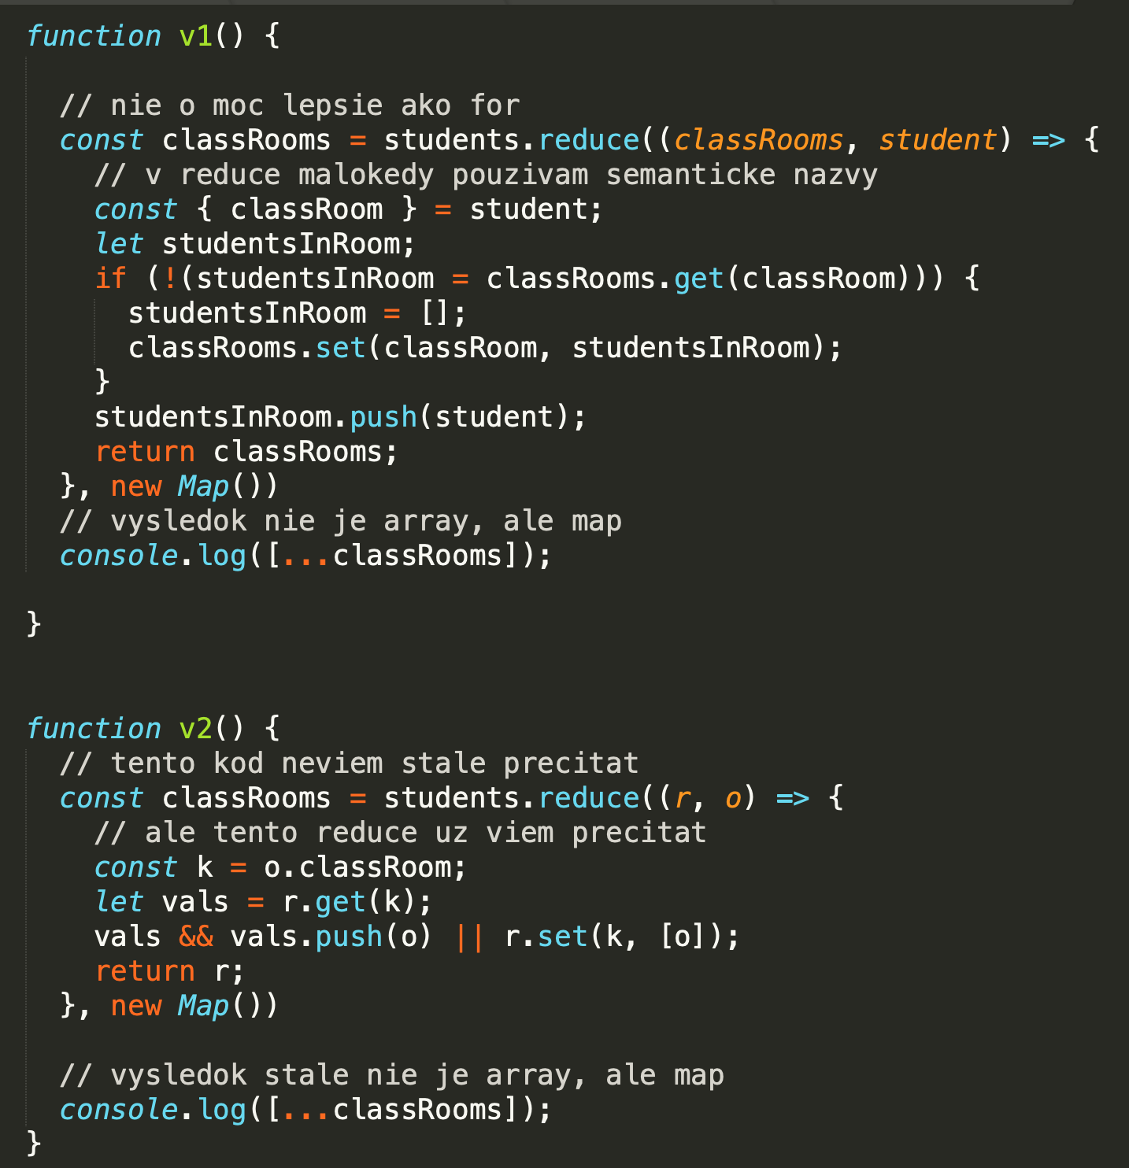






Reduce – common usecases
Transform [] to Map
To create groups/counts
Pozrite si zdrojáky a komentáre v 08-prednaska/samples/01-iteration-functions/06c-reduce-map.js
https://developer.mozilla.org/en-US/docs/Web/JavaScript/Reference/Global_Objects/Array/reduce

Slide 16
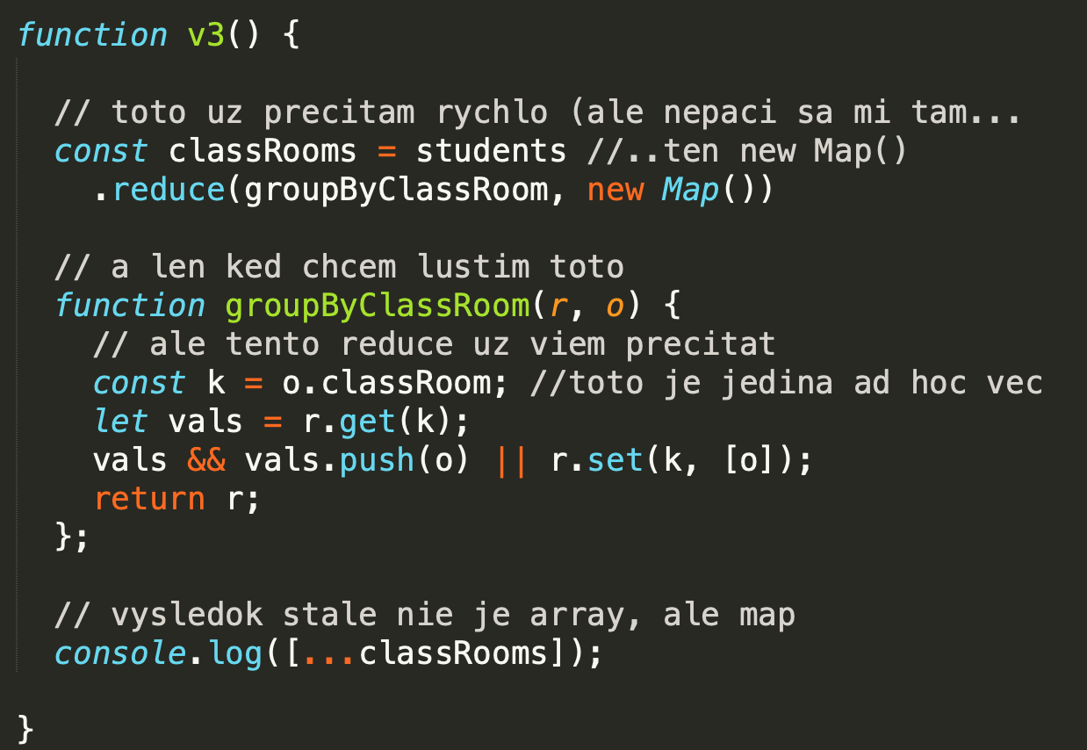





Reduce – common usecases
Transform [] to Map
To create groups/counts
Toto je V3, taká nejaká varianta v strede toho ako by sa to dalo priemerne napísať
https://developer.mozilla.org/en-US/docs/Web/JavaScript/Reference/Global_Objects/Array/reduce

Slide 17
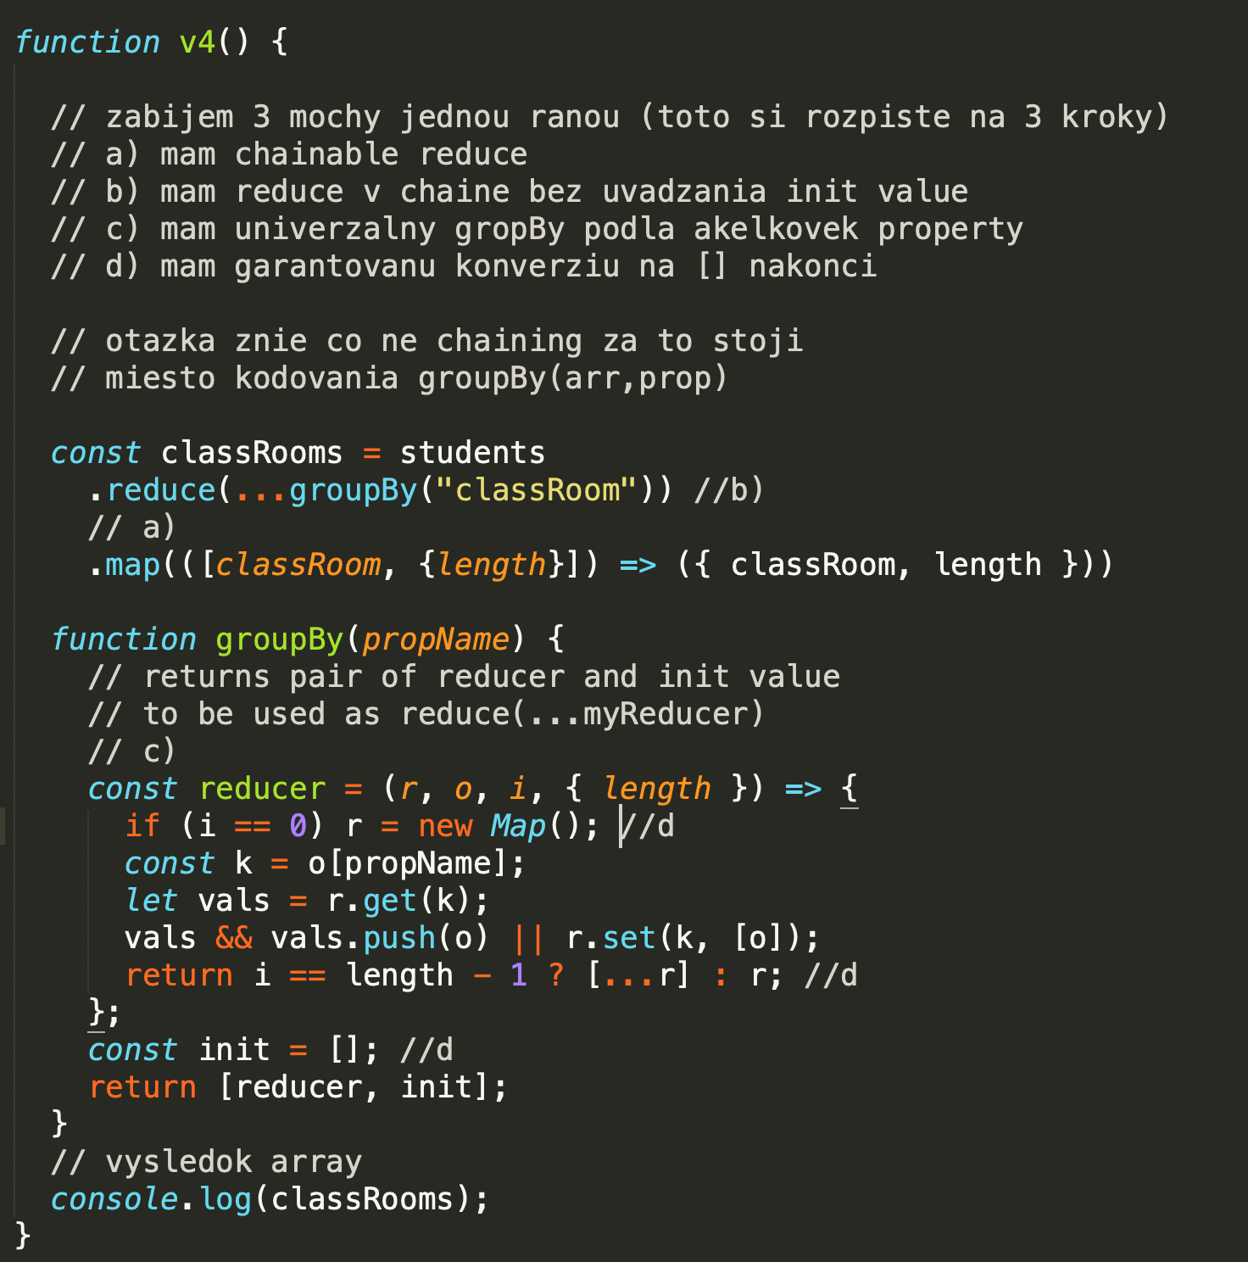






Reduce – common usecases
Transform [] to Map
To create groups/counts
V4 extrémna varianta ako to teraz píšem ja v poslednej dobe
A ešte si ukážeme nabudúce, ako to zuniverzálniť, keď propName nebude string ale funkcia
https://developer.mozilla.org/en-US/docs/Web/JavaScript/Reference/Global_Objects/Array/reduce

Slide 18
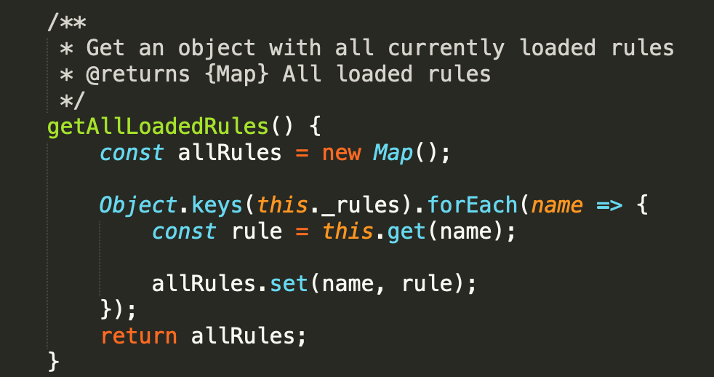
forEach is almost evil as for loop
What is correct functional equivalent of this ? Reduce
Why they did not write it as reduce ?
Because another OO evil => this
and because array.reduce has no thisArg
sample: code is from ESLint source code
Notes:
Su pripady kedy napisem kludne forEach aj dokonca niekolko nestovanych forEach ked mi to pride
Citatelnejsie a rychlejsie napisatelnejsie
A zapis z reduce alebo inymi vecami by nebol o moc citatelnejsie.
Najme ak potrebujem performance a jeden prebeh a zbieram si rozne premenne po ceste do scopovanych variables.....

Slide 19
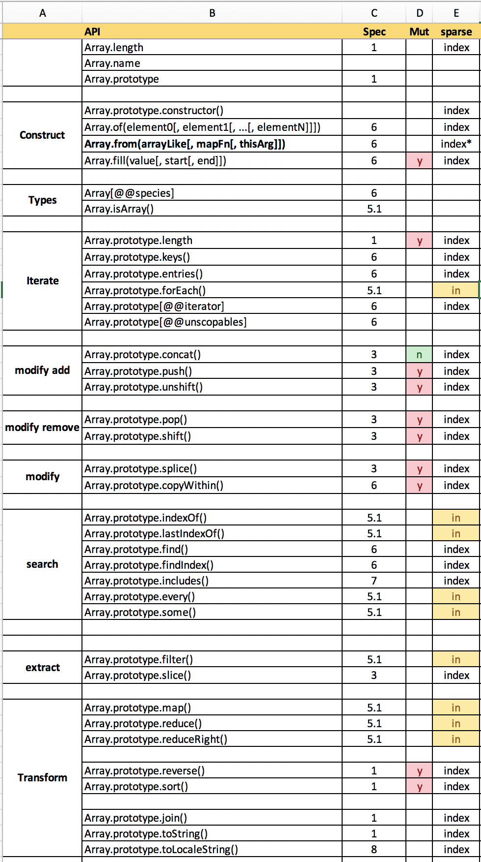

array extras vs. for loop iterating arrays
máme sparse arrays
a su dva sposoby iterovania nad array, podla pouziteho API
over index from 0 to length-1 (vsecky itemy)
ostatne
over defined array keys (iba definovane itemy)
Array.prototype.forEach()
Array.prototype.indexOf()
Array.prototype.lastIndexOf()
Array.prototype.filter()
Array.prototype.map()* – but returns length
Array.prototype.every()
Array.prototype.some()
Array.prototype.reduce()
Array.prototype.reduceRight()
Excel je tu: /02-prednasky/js-api-doc.xlsx
https://developer.mozilla.org/en-US/docs/Web/JavaScript/Reference/Global_Objects/Array
Notes:
Mame uz aj novsie funkcie v exceli nie su Array.flat atd... Pozri MDN.

Slide 20
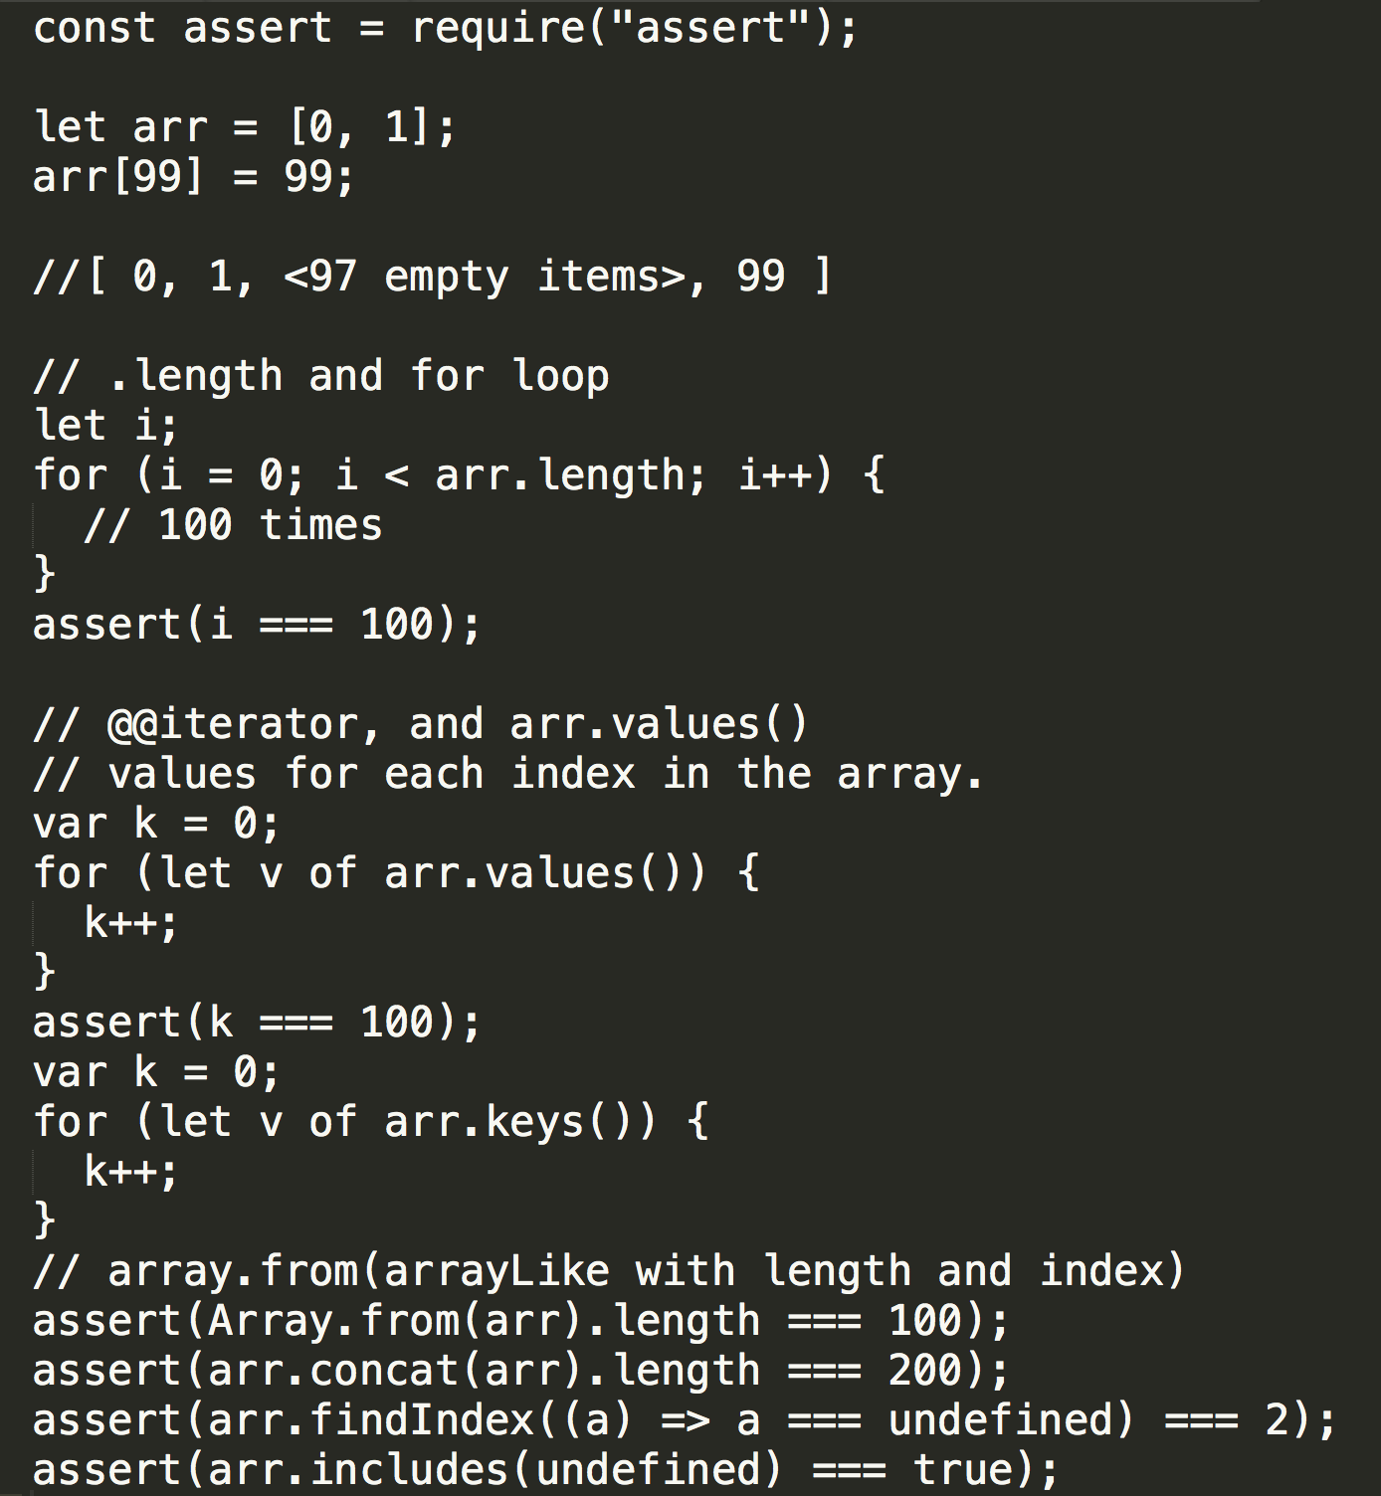

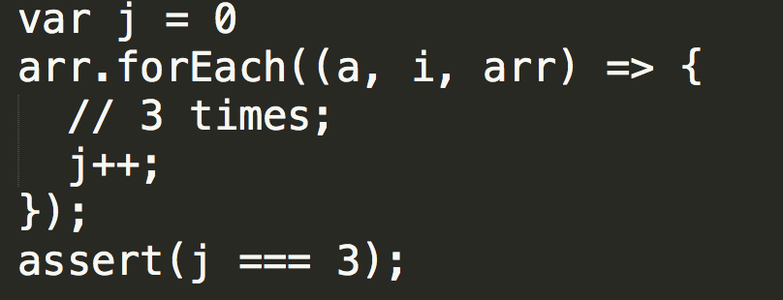
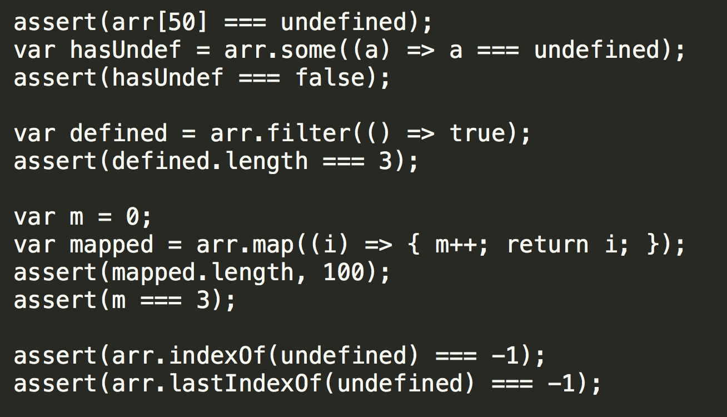
array extras vs. for loop

Slide 21
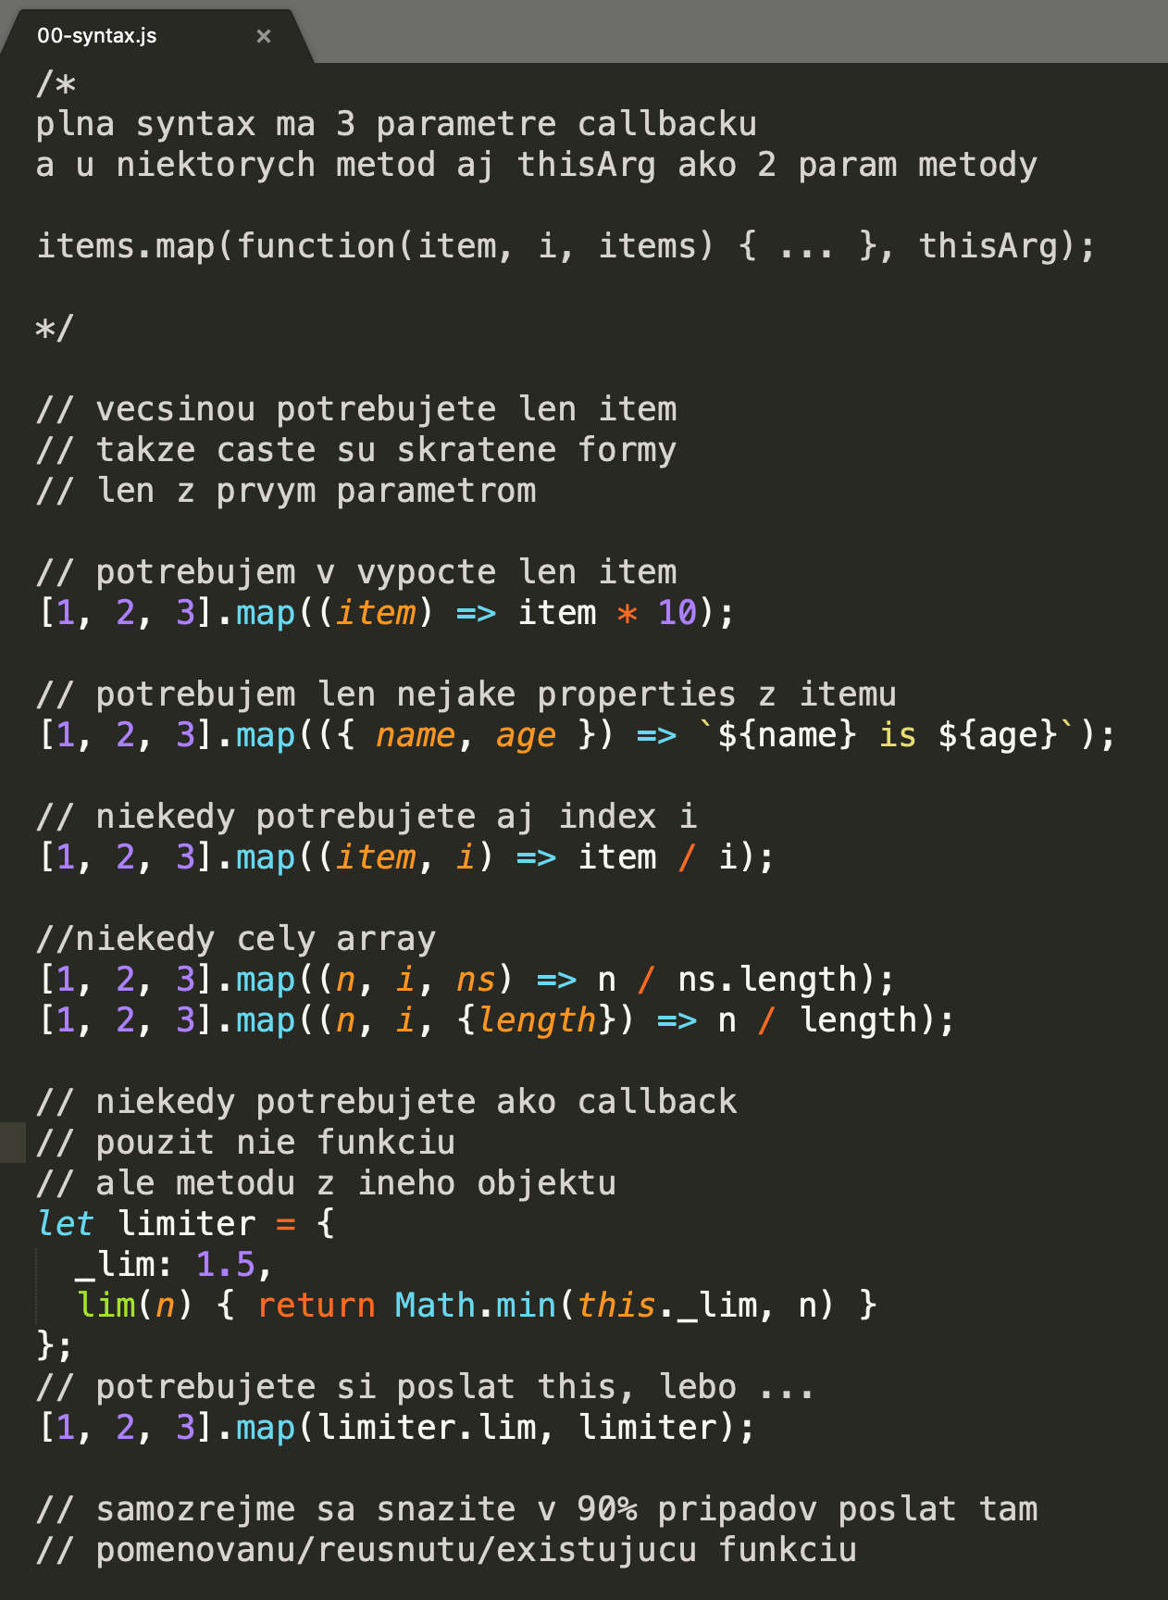
Syntax
1. param - callback je funkcia
Existujúca JS/API funkcia
Reusnuta funkcia
Inline arrow/function
2. param – thisArgs, len u niektorych funkcii
Možnosť poušiť metódu ako callback
Možnosť poslať dodatočný „parameter“ do bežnej funkcie (faster then scope lookup)
samples/01-iteration-functions/00-syntax.js

Slide 22
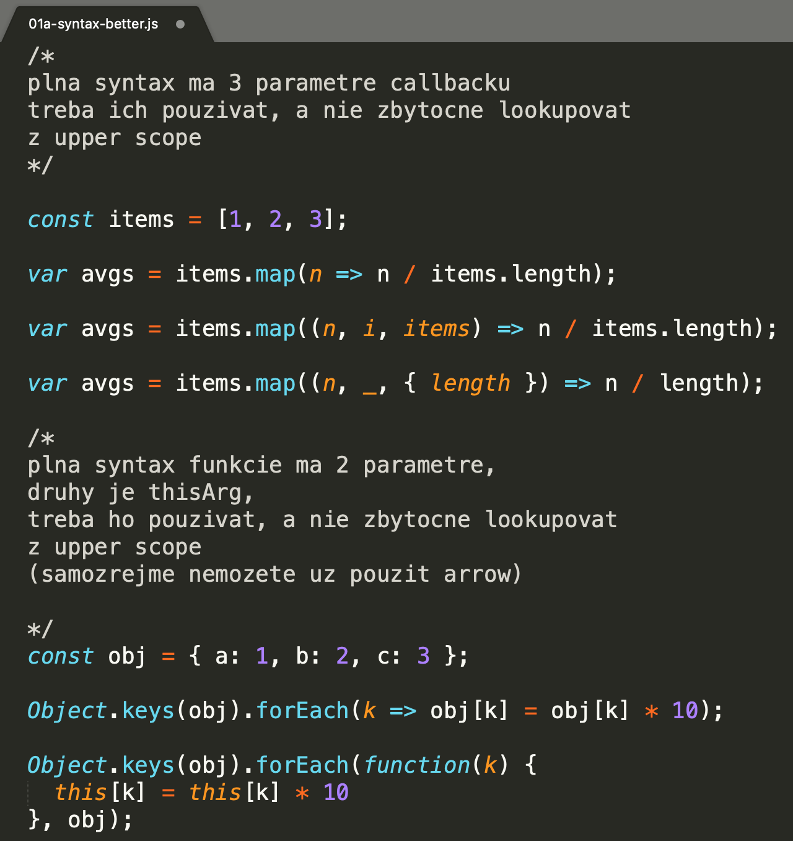
Syntax - often unused
thisArg, map, filter, some, every – signature ma 2 param
benefits: using methods as callbacks
passing extra value (avoiding scope lookup)
3rd param of callback, the array itself
samples/01-iteration-functions/01a-syntax-better.js
Notes:
Ten sample sa da napisat kadejako,
Potrebujeme iterovat cez properties objektu a vo vnutri potrebujeme
Key aj Value a aj Object
Ku key a value sa vieme dostat aj inak (Obeject.entries())
Ale k samotnemu objektu nie,
Takze mame dve moznosti,
Bud ho budeme citat zo scopu nad nami
Alebo si ho posleme do funkcie ako this
Samozrejme prioritne to bolo vymyslene na to, aby sa dali ako iterator callbacky pouzivat metody objektov.

Slide 23
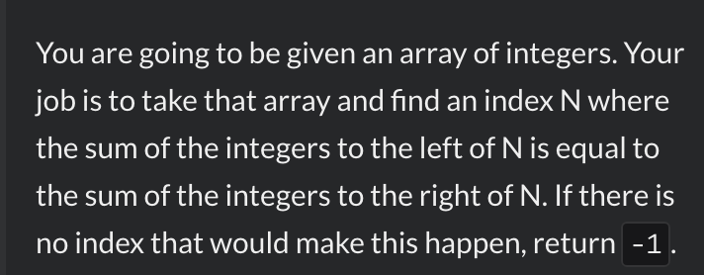

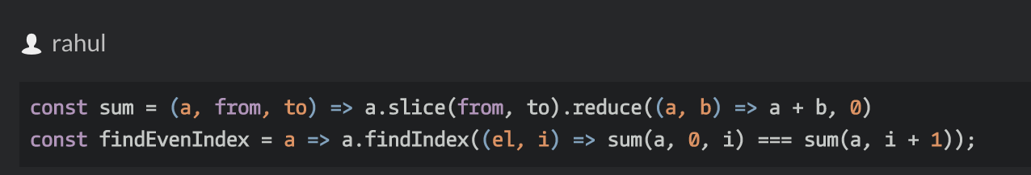
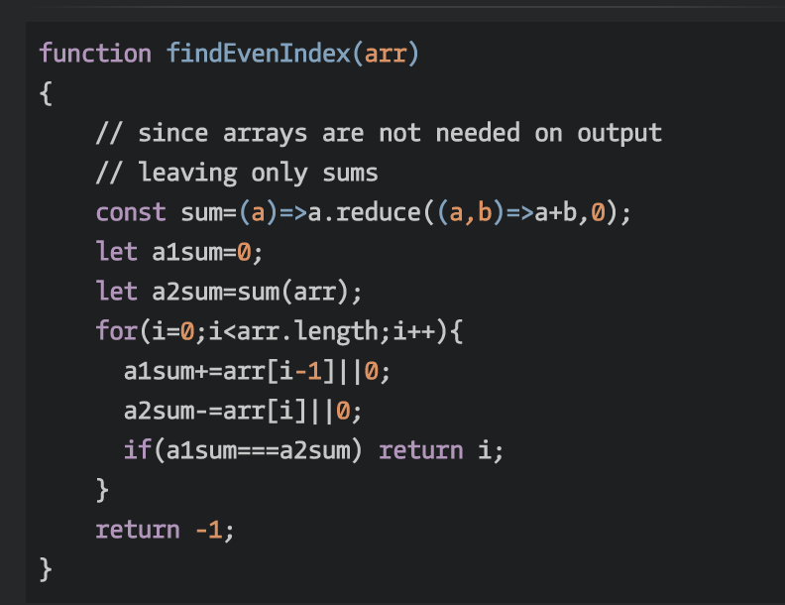


















semantic code ”real world” samples
https://www.codewars.com/kata/equal-sides-of-an-array/train/javascript
ainthek, perf. oriented solution
TODO performance: spočítajte zložitosť algoritmov
Notes:
Dalsi krasny priklad kde kod zodpoveda zadanemu textu zadania.
Toto sa Vam skutocne oplati, ak dokazete dostavat alebo formulovat/reformulovat zadania
Tak aby vyjadrovali „co chcete dosiahnut“ a nie „algoritmicky“ ako to chcete dosiahnut.
Vtedy je FP ozaj silny a rychly a bezpecny sposob ako z „biznis“ zadania spravit kod.

Slide 24
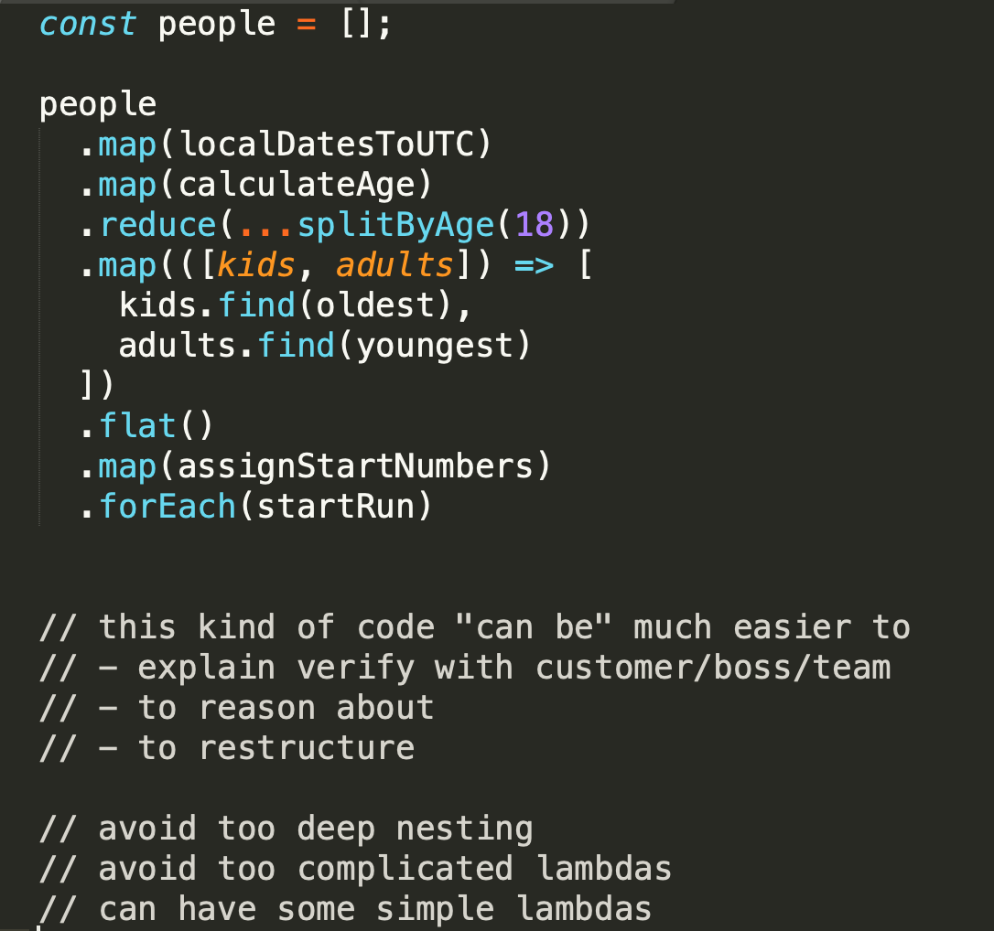
Programovanie z iterative functions (array extras)
Program pozostáva zo sekvencie transformácii
Buď preto lebo z povahy zadania je to ozaj sekvencia transformácii
Alebo preto lebo sa to tak lahsie (postupne) kóduje
Alebo preto lebo sa nám to pri zmenách bude ľahšie preskladávať
Ak si spomenie na async prednášku aj tam sme sa snažili program sekvencie/paralelizmy zapísať podobne deklaratívne
A ešte sa s tým stretneme u streamov

Slide 25
Objects as data
Všetko co sme si ukazovali funguje na []
Na {} nemáme takéto extras, ale ak chceme dokážeme object properties skonvertovat na [] of entries a nazad [] of entries na {}
Z prednášky o objektoch by ste mali poznať aspoň 3 metódy na to prvé
A) Object.????() -> []
B) Object.fromEntries([]) -> {} (draft 2019)

Slide 26
function composition

Slide 27
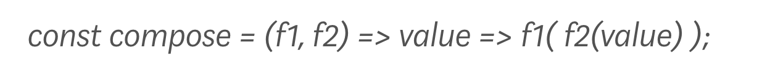
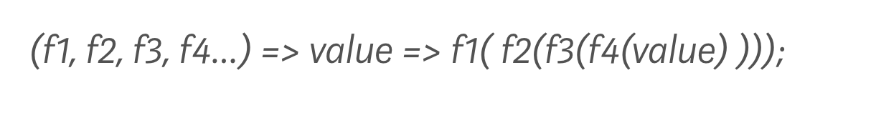
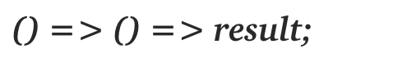

composition - definitions
In computer science, function composition is an act or mechanism to combine simple functions to build more complicated ones.
Like the usual composition of functions in mathematics, the result of each function is passed as the argument of the next, and the result of the last one is the result of the whole.
In mathematics, function composition is the pointwise application of one function to the result of another to produce a third function
composition of functions deals with finite data and sequential execution
when speaking about infinite data (e.g. streams) and possibly parallel processing we call it pipeline (don’t confuse with pipe() on other slides)
ES2015 ArrowFunctionExpression:
https://medium.com/@dtipson/creating-an-es6ish-compose-in-javascript-ac580b95104a

Slide 28
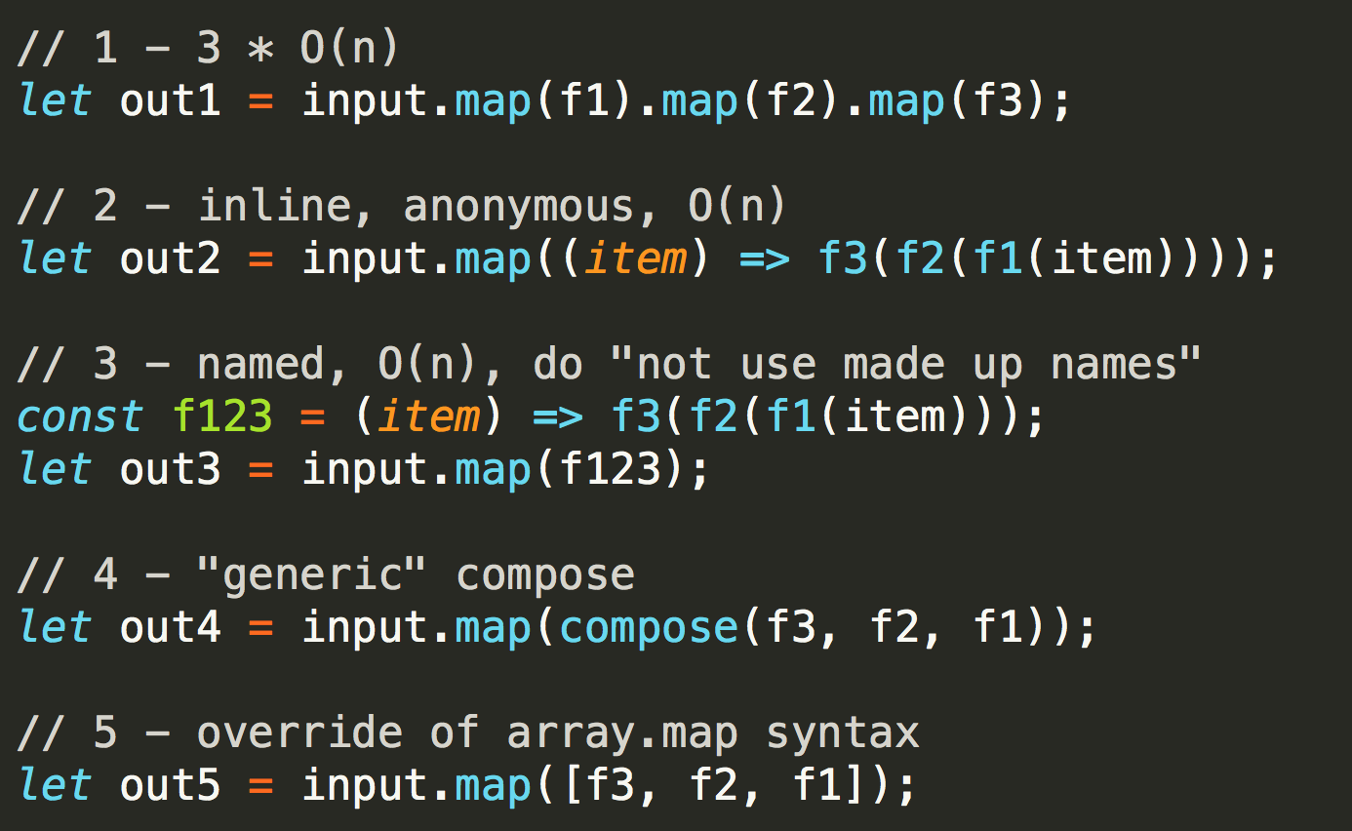
Composition styles inline, adhoc, generic
1. readable
reused,
slow 400ms
2. readable,
reused
fast 120ms
3. readable,
reused
fast 120ms
4. readable,
reused
fast 153ms
slow 300ms *
5. readable
reused,
non standard
samples/02-function-composition/01-composition-styles.js

Slide 29
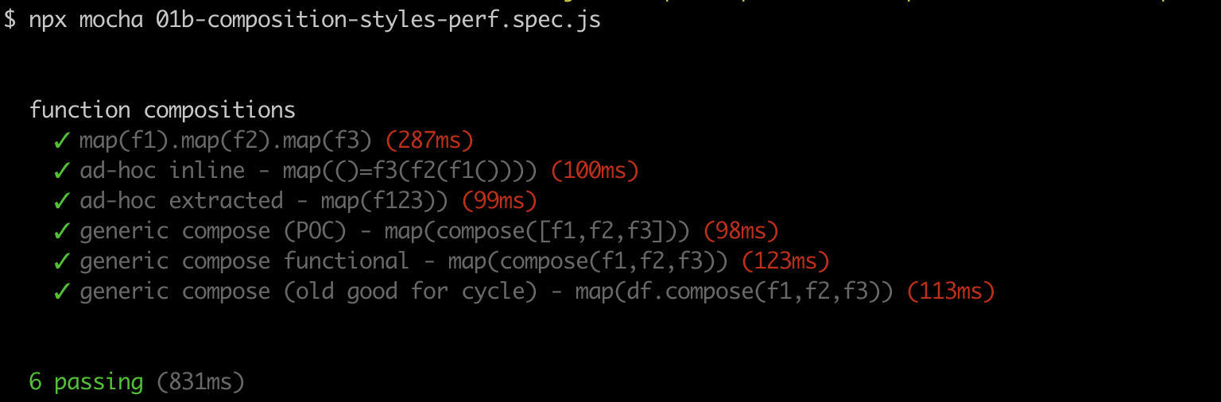
Composition styles – performance view
Môžete sa pohrať sami, naivný test (nie ozajstný banchmarking) ale na predstavu to postačuje
Stále sa bavíme o tom, že všetko je kompromis medzi čitateľnosťou, pisateľnosťou, performance, bezpečnosť, flexibilita, robusnosť....
2019-javascript/08-prednaska/samples/02-function-composition/01b-composition-styles-perf.spec.js

Slide 30
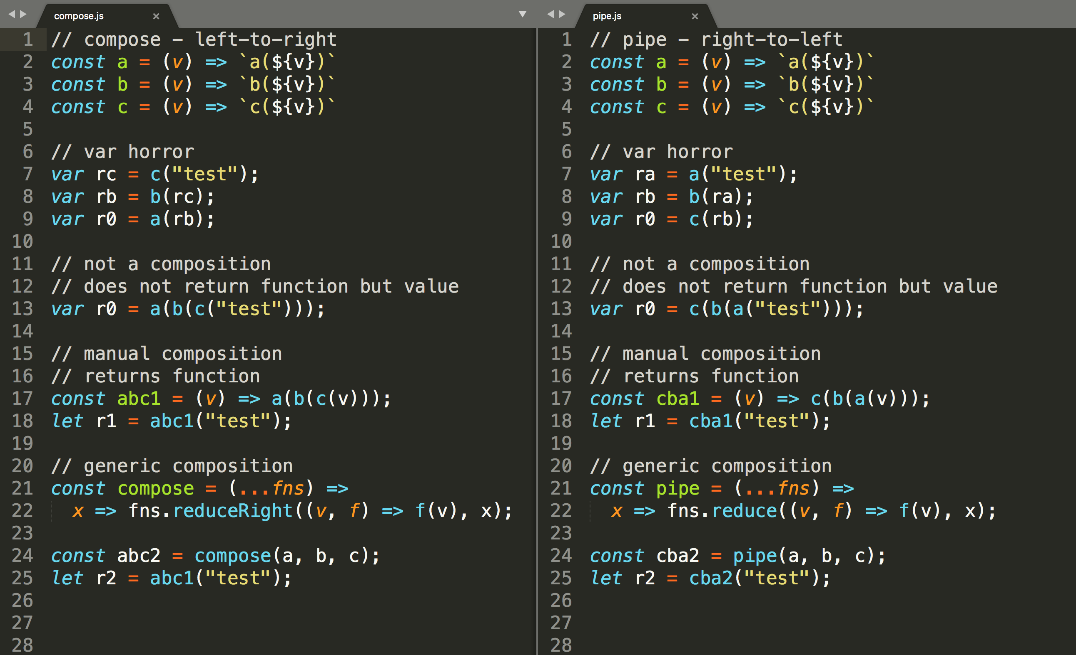
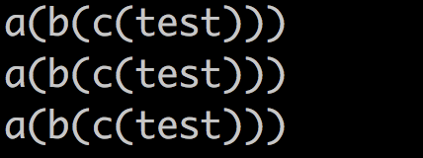
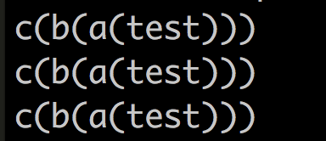
Composition – compose and pipe
function composition is an act or mechanism to combine simple functions to build more complicated ones.
2 general compositions:
compose – left-to-right
pipe –
right-to-left
samples/02-function-composition/02a-compose.js
samples/02-function-composition/02b-pipe.js
Notes:
na riadku 25 je chyba ma sa tam volat abc2

Slide 31

other composition
compose, pipe – well known, well named
and, or, ….
TODO: find libraries having other ad hoc compositions, study and compare codes

Slide 32
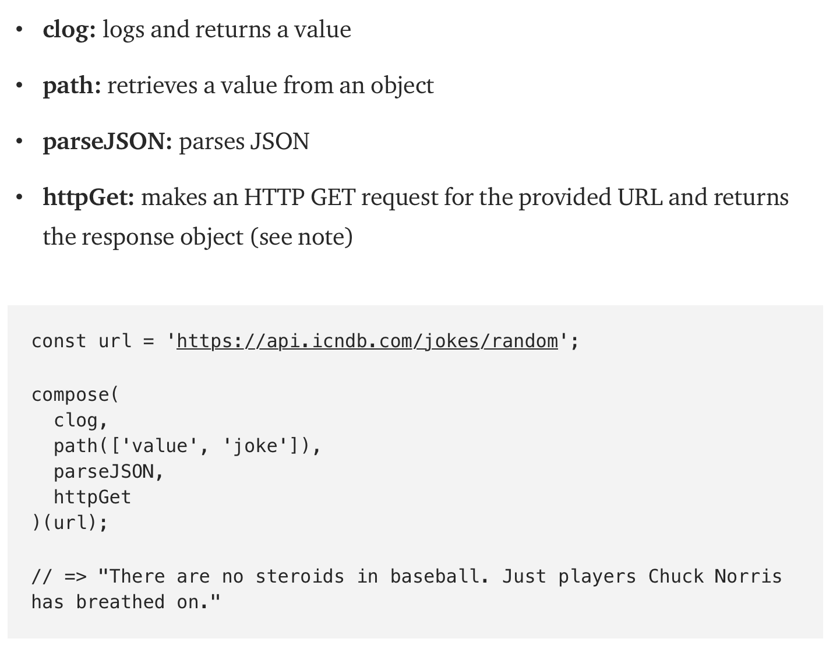
Why to use composition
Instead of jamming functions within functions or creating a bunch of intermediate variables, let’s pipe all the things!
Those who prefer functional programming would tell you that the compose is more declarative. Instead of telling you how the function works, it tells you what it does!
Functional composing can be a lot of fun as seen in the previous examples plus leads to more elegant and reusable code if applied correctly.
https://medium.com/@wpcarro/stop-writing-for-loops-compose-7d4ac507bd36

Slide 33

Functional vs. OO, do we have to choose ?
Keep it sane
function is basic (JS) construct
functions to methods
methods to functions

Slide 34
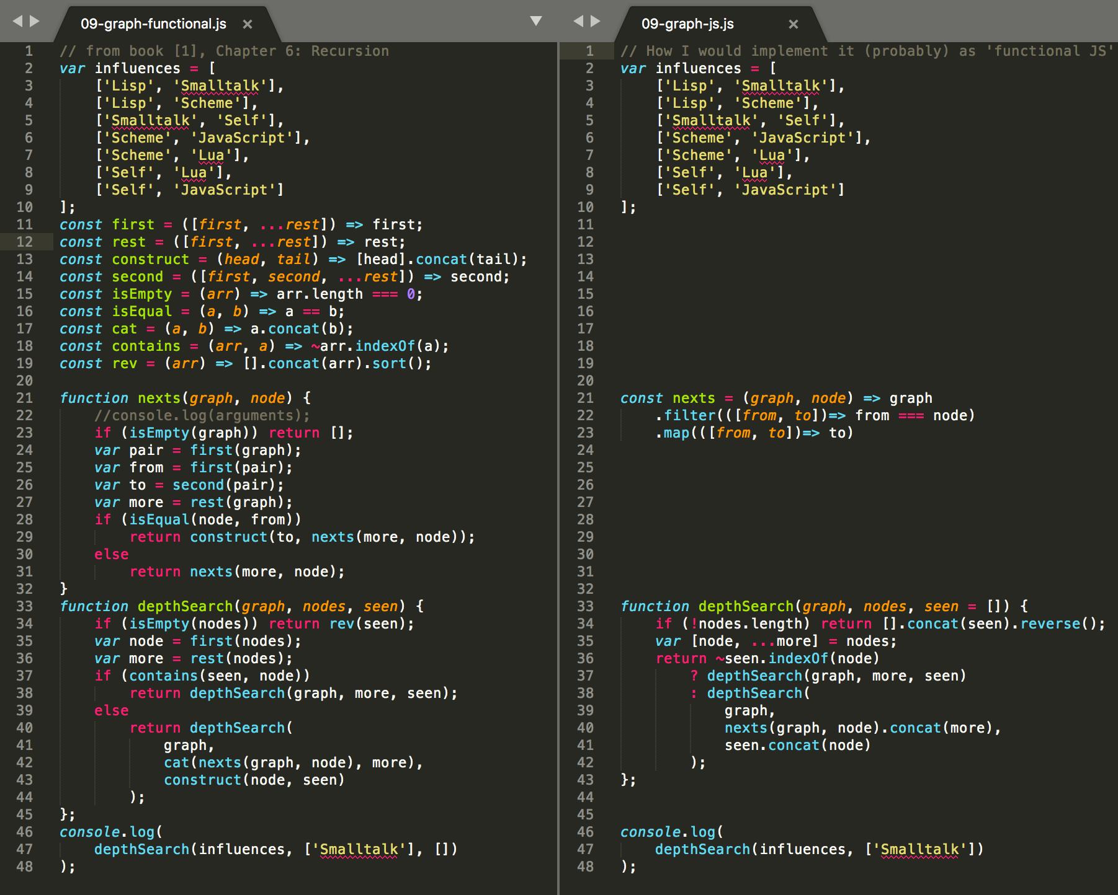
JavaScript - too much functional ?
Alebo čo sa stane, keď to “preženiete”.
is this still JavaScript ?
how many JS people
will have to read it,
and will understand ?
Do you want to study
custom APIs (vocabularies) or use
“idiomatic JS” (for common oneliners) ?
is recursion really “best” for this structure parsing ?
is functional really best for this ? (internal data structure hiding)
which functions are really reusable ?

Slide 35
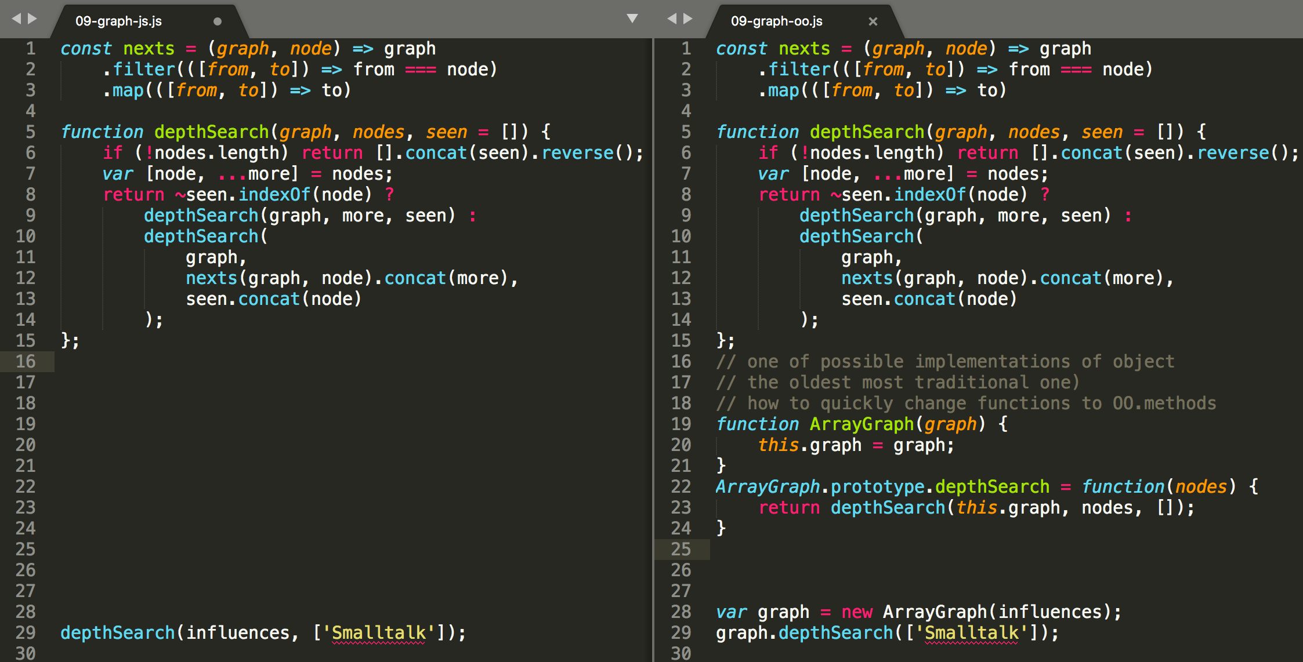
JavaScript - from functions to object+methods

Slide 36
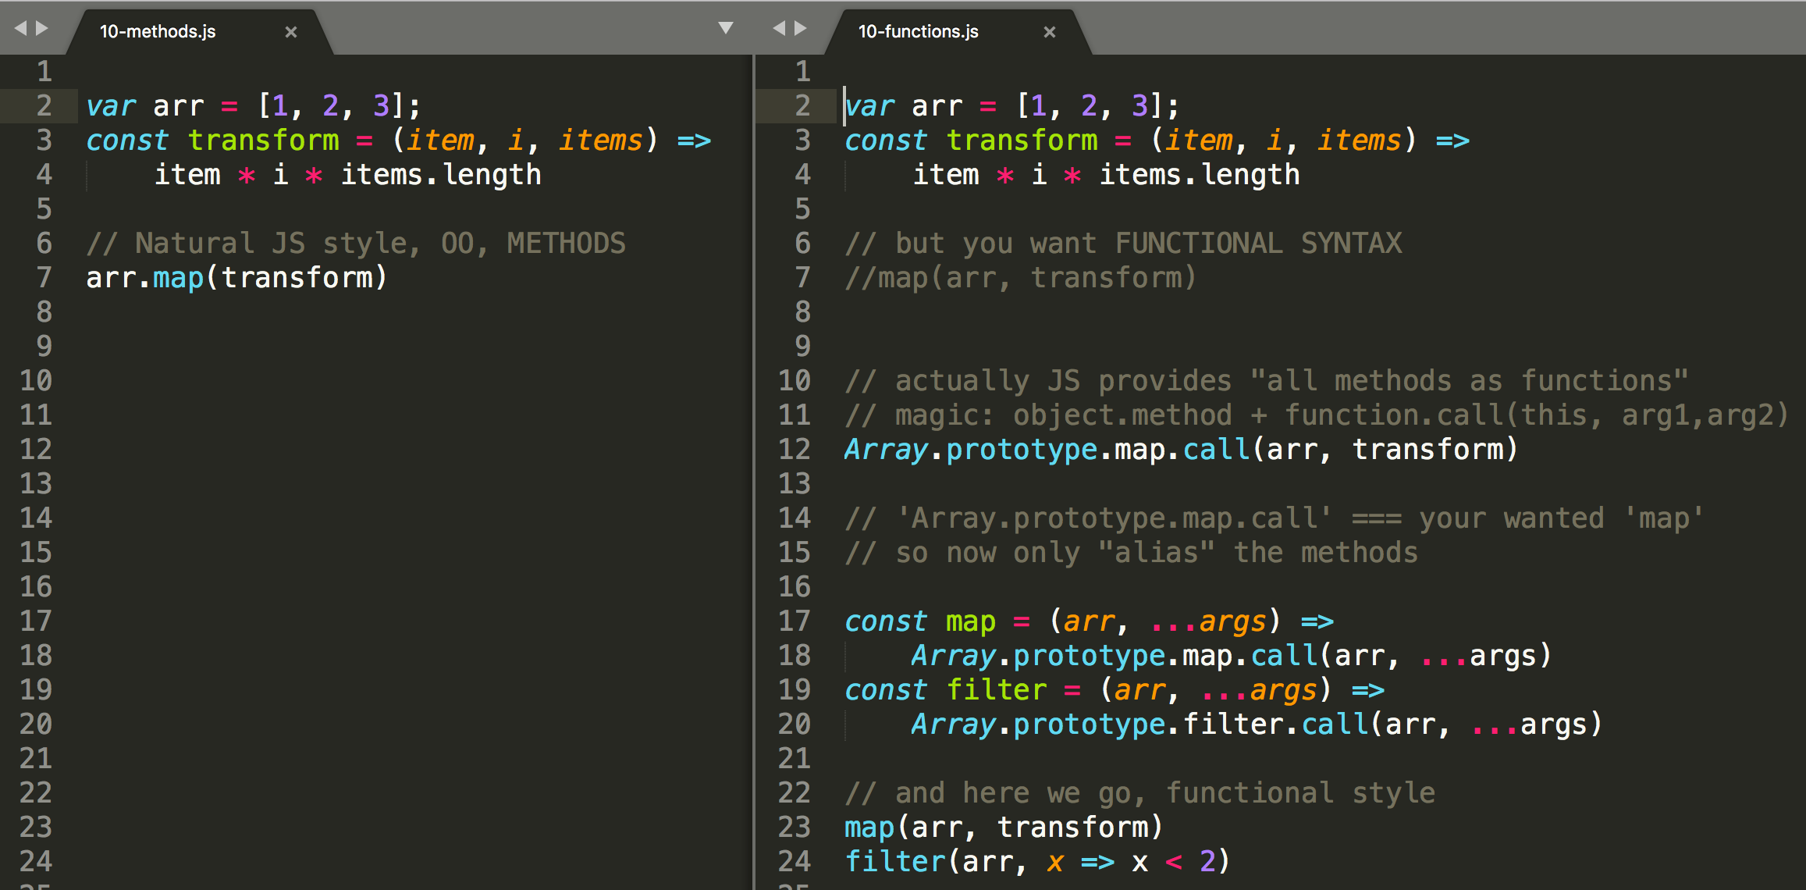
JavaScript - from methods to functions

Slide 37
Pure functions

Slide 38
Pure functions
Referential transparency: The function always gives the same return value for the same arguments. This means that the function cannot depend on any mutable state.
Side-effect free: The function cannot cause any side effects. Side effects may include I/O (e.g., writing to the console or a log file), modifying a mutable object, reassigning a variable, etc.

Slide 39
Pure functions
Benefits of pure functions:
easier to reason about and debug because they don't depend on mutable state
return value can be cached or "memoized" to avoid recomputing it in the future.
easier to test because there are no dependencies

Slide 40
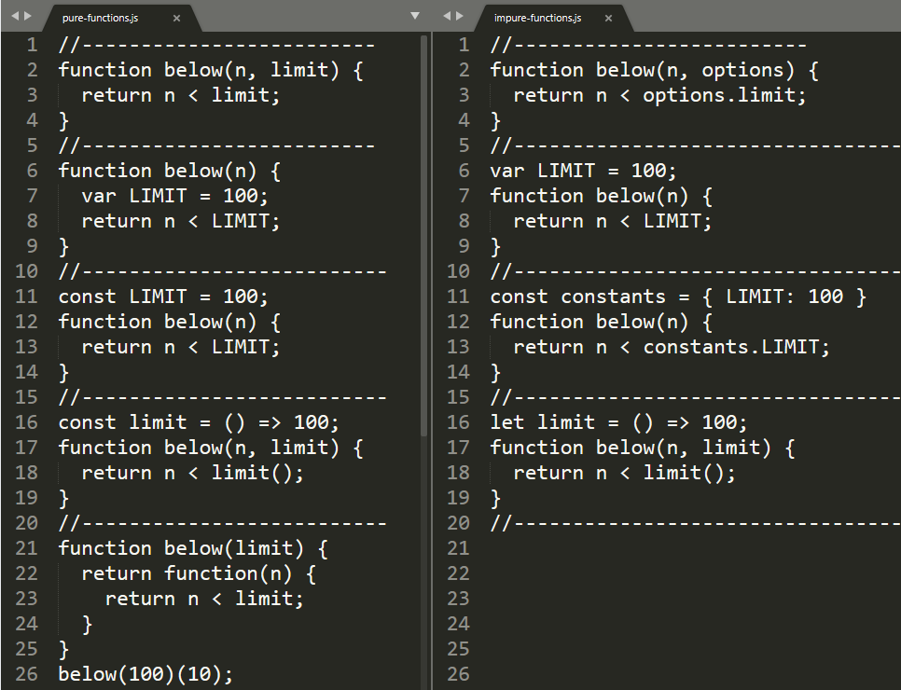
pure functions
function cannot depend on any mutable state
Bad - dependency on:
captured let, var
captured const but with with mutable value
dependency on mutable or impure function
methods are impure by definition
Ok – dependency on:
no captured variables
captured primitive const
captured frozen object const
on constant and pure function
on immutable captured argument

Slide 41
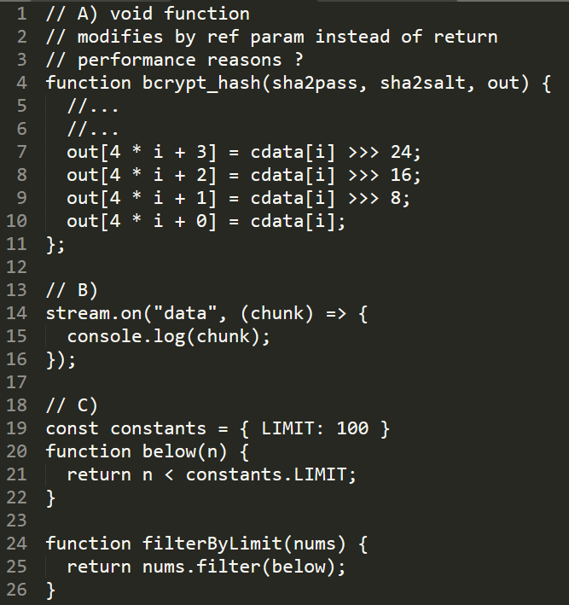
pure functions
Side-effect free
function must return value, if not it is noop or exists to perform side effects
No IO
console.log,…
http, net,…
fs, process,…
DOM, XHR
Use internally pure functions
pure function calling impure becomes impure

Slide 42
Pure vs impure functions
Any meaningful program will contain also impure functions (Ajax call, I/O calls, check the current date, or get a random number,...). rule of thumb is to follow the 80/20 rule: 80% of your functions should be pure, and the remaining 20%, of necessity, will be impure.
The general idea is that you write as much of your application as possible in an FP style, and then handle the UI and all forms of input/output (I/O) (such as Database I/O, Web Service I/O, File I/O, etc.) in the best way possible for your current programming language and tools
https://opensource.com/article/17/6/functional-javascript
https://alvinalexander.com/scala/fp-book/pure-functions-and-io-input-output

Slide 43
Functional vs. OO, do we have to choose ?
Funkcia je základ
Nie len v JS
Ak máte rozumné funkcie vždy ich dokážete
Prilepiť na objekt
Konvertnúť z metód na funkcie
Wrapnúť
Bindnuť im parametre
Zmeniť this....
....
Snaha o pure/impure podľa toho čo kódujete
Základ je nepísať 10ky riadkov štrukturovaného balastu, ale pekne kódovať funkciami

Slide 44

Zvyšok na budúce......

